Slide 1
LANGUAGE TRANSLATION SERVICE
Group 16
Vaishnavi Koyyada (vkoyyada)
Thilak Reddy Dharam (thilakre)
Teja Naveen Chintapalli (tejanave)

Slide 2
ABSTRACT
In the globalized world, the importance of overcoming language barriers cannot be overstated. These slides introduces a groundbreaking neural machine translation service designed to translate between Romanian to English and French to English. Utilizing the extensive Europarl corpus Datasets, this service incorporates advanced natural language processing techniques.

Slide 3
Dataset Description
Europarl Dataset: A cornerstone in computational linguistics and machine translation, especially for projects like ours focusing on Romanian to English and French to English translations.
Wide Language Coverage: Encompasses 21 European languages, with a focus on Romanic languages including French and Romanian, alongside English.
Language | Number of Sentences
Romanian - English | 399,375
French - English | 2,007,723

Slide 4
Data Engineering
Reading Raw Text Files
Sentence Processing: Split sentences, remove leading/trailing spaces, and normalize non-ASCII characters.
Text Standardization: Convert all words to lowercase, remove punctuation, and filter out non-alphabetic characters.
Saving Preprocessed Data: Save preprocessed sentences in separate pickle files for each language.
Data Loading and Vocabulary Creation: Load preprocessed data, create data frames, and combine language vocabularies.
Word Index Mapping: Map each word to a unique index for numerical model input.
Identifying Sentence Prefixes: Identify specific prefixes in English sentences for diverse starting phrases.
Pairing and Filtering Sentences: Select and pair sentences based on criteria like length and starting prefixes.
Converting Sentences to Tensors
Dataset Creation: Use tensors to create custom datasets for training and validation.
Data Loader Objects: Create loaders to feed data in batches during training and validation.

Slide 5
Models
Encoder – Decoder Model.
Encoder – Decoder Model with Attention Mechanism.
T5 Transformer Model.
Marian MT Model.

Slide 6
Encoder-Decoder Model
Two Core Components : Encoder and Decoder
Encoder: Transforms input sequence into a context vector (hidden state).
Components:
Embedding Layer: Maps each input token to a vector.
GRU Layer: Processes the sequence with initializing the batch size.
Dropout Layer: Prevents overfitting, with a specified dropout probability.
Decoder: Complement to Encoder: Hidden layer size matches Encoder's, with output size equal to output vocabulary.
Components:
Embedding Layer: Maps each target token to a vector.
GRU Layer: Processes the sequence.
Linear Layer: Maps GRU output to output vocabulary size.
Dropout Layer: Similar to Encoder's.

Slide 7
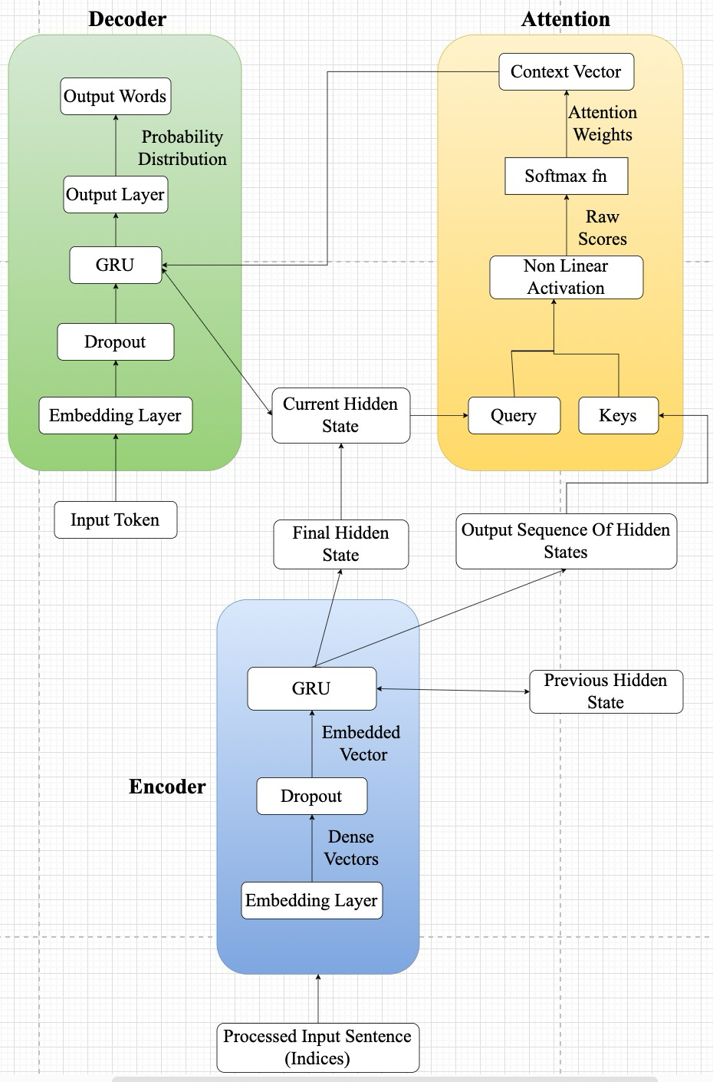
Encoder-Decoder Model With Attention Mechanism
Encoder RNN:
Components:
Embedding: Converts input tokens into embeddings.
GRU: Processes embeddings sequentially.
Dropout: Regularization to improve generalization.
Attention:
Components:
Linear Layers : Project query and keys into common space.
Attention Calculation: Calculates attention score from tanh activation of projected query and keys.
Softmax: Normalizes attention scores into weights.

Slide 8
Encoder-Decoder Model With Attention Mechanism
Attention Decoder RNN:
Components:
Embedding: Converts decoder input tokens into embeddings.
Attention: Focuses on different parts of the input sequence.
GRU: Processes combination of embeddings and context vectors.
Linear Layer: Transforms GRU output to output space.
Softmax: Generates probabilities for output tokens.

Slide 9
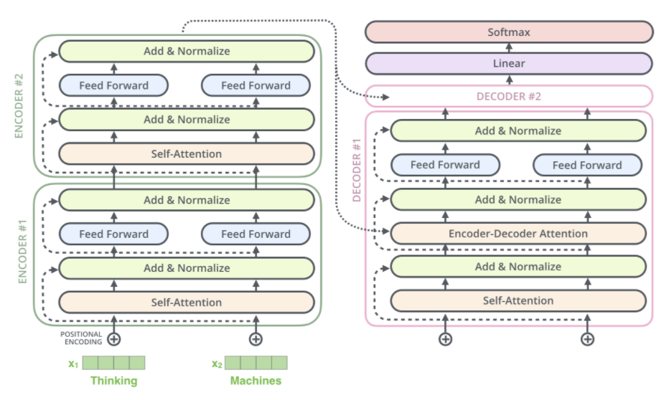
Text-to-Text Transfer Transformer (T5) Model
The Text-to-Text Transfer Transformer (T5) is an advanced model developed by Google Research, building upon the foundational Transformer architecture with a novel approach to NLP tasks.
T5's design includes encoder and decoder blocks, each comprising layers with self-attention mechanisms and feed-forward neural networks, along with positional encodings to preserve word order in inputs. Key features like layer normalization and residual connections in each block enhance training stability and gradient flow during backpropagation.
T5 standardizes various NLP tasks into a text-to-text format, simplifying the NLP pipeline. Its pre-training involves tasks like filling in missing words, enabling it to understand language nuances and generalize across different tasks without needing task-specific architectural changes

Slide 10
Marian MT Model
Marian MT, developed primarily by the Microsoft Translator team, is a state-of-the-art neural machine translation framework known for its efficiency and performance.. A key feature of Marian MT is its support for training custom models on specific language pairs, which makes it highly adaptable for a wide range of translation tasks.
Marian MT's architecture, built on the Transformer model, is enhanced with several sophisticated features. It employs layer normalization in each encoder and decoder layer, aiding in learning stability and faster convergence. Positional encoding is integral, providing crucial sequence order information, compensating for the self-attention mechanism's inherent lack of contextual awareness. The architecture also includes feed-forward networks within each layer, further processing the attention mechanism's output to capture complex textual relationships. Additionally, residual connections are implemented around each sub-layer to combat the vanishing gradient problem common in deep networks.

Slide 11
Loss Function
Negative Log-Likelihood (NLL) Loss
Negative Log-Likelihood (NLL) Loss is a crucial loss function models that output probabilistic predictions. It calculates loss by taking the negative logarithm of the probability
Other Loss Function tried:
Cross Entropy Loss
Cross-entropy loss measures the difference between two probability distributions - the actual output and the predicted output, making it a widely used loss function in classification tasks

Slide 12
Optimization Algorithms
Adam Optimizer: The Adam Optimizer, standing for Adaptive Moment Estimation is highly effective in language translation models, enabling rapid convergence and enhanced performance through efficient navigation of complex optimization challenges.
Other Optimization Algorithms tried:
Adagrad (Adpative Gradient) Optimizer
Adagrad's rapidly decreasing learning rates and less effective handling of dense data reduce its suitability for language translation tasks.
SGD (Stochastic Gradient Descent) Optimizer
SGD's lack of adaptive learning rates and slower convergence make it less efficient for the intricate and interdependent parameter adjustments required in language translation models.

Slide 13
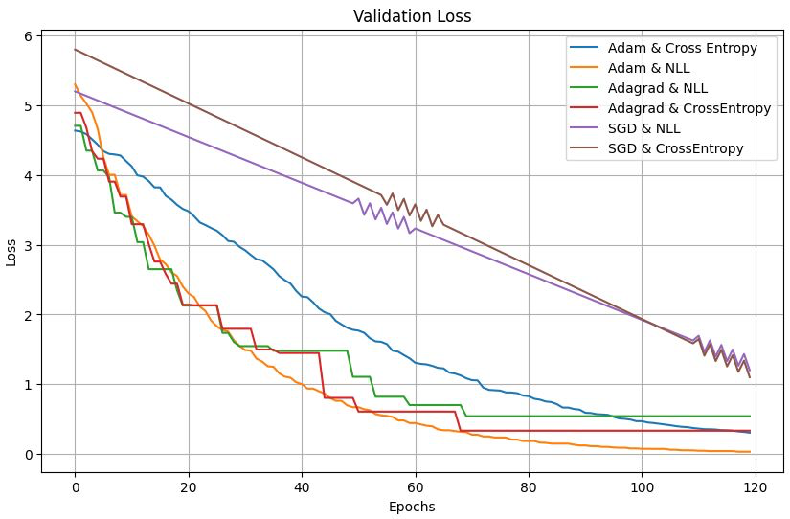
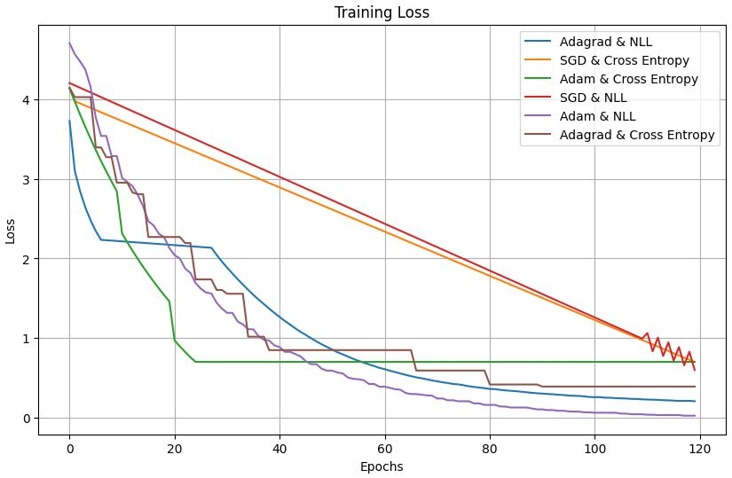
Validation Loss on different optimization and Loss Functions
Training Loss on different optimization and Loss Functions

Slide 14
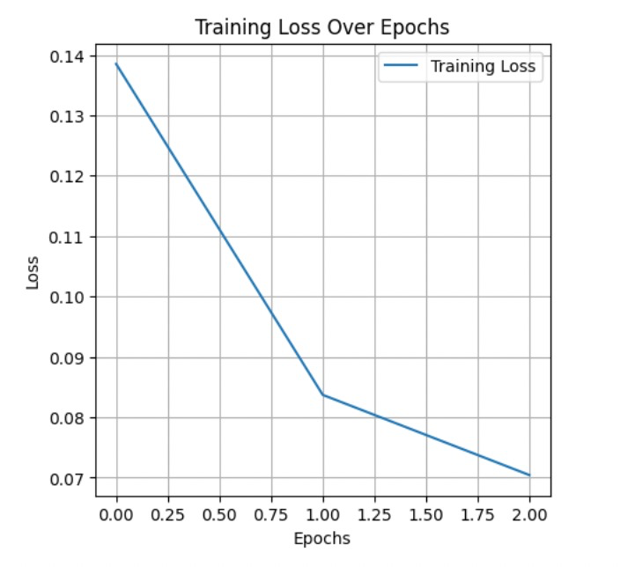
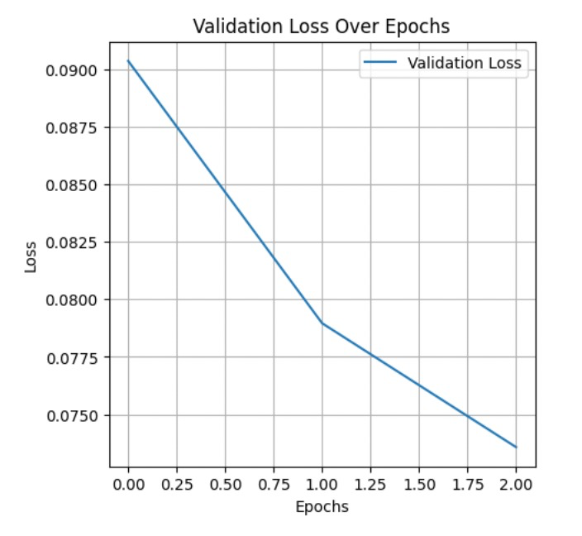
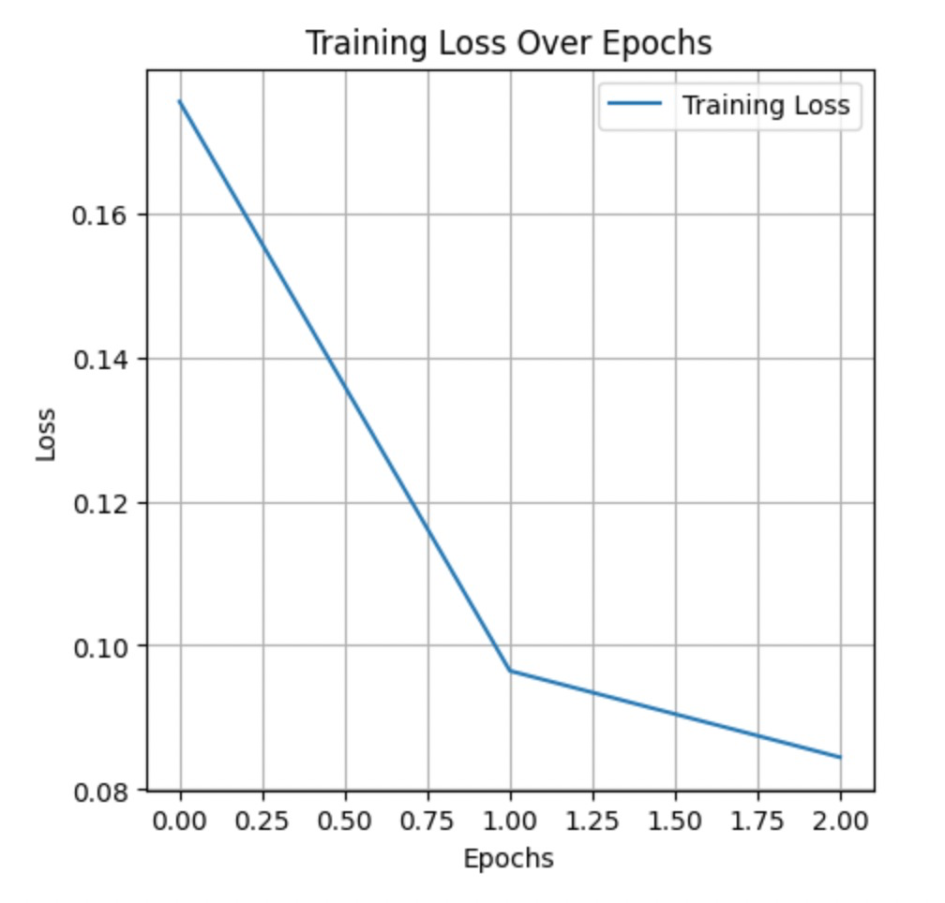
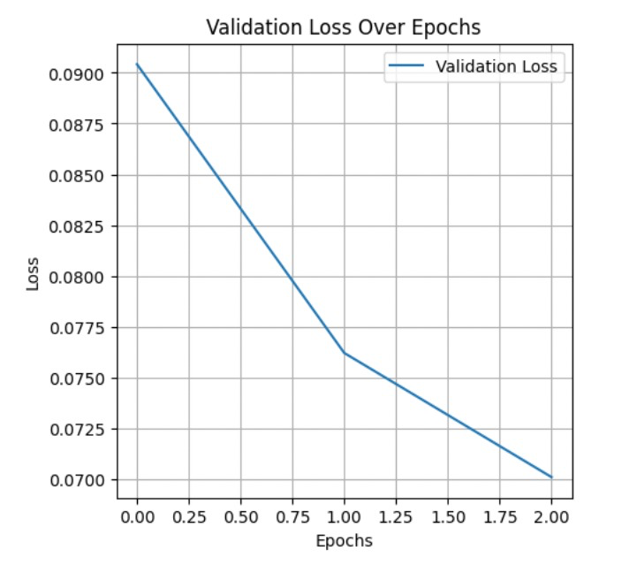
Marian MT
T5 Model

Slide 15
Evaluation Metrics
BLEU Score (Bilingual Evaluation Understudy): BLEU Score evaluates the quality of machine-translated text by comparing it with one or more reference translations, emphasizing the frequency of correctly predicted words or phrases.
METEOR Score (Metric for Evaluation of Translation with Explicit Ordering): METEOR Score evaluates translation quality by considering both precision and recall, and includes additional features like synonym matching and stemming.
BERT F1: This metric, captures the contextual alignment of the predicted and reference texts, offering a more in-depth analysis than traditional F1 measures.
BERT Precision: BERT Precision leverages BERT's deep understanding of context and language nuances, offering a more refined precision measurement.
BERT Recall: BERT Recall calculates recall, the proportion of correctly predicted positive observations to all actual positives, using BERT embeddings.

Slide 16
Evaluation Metrics on Different Models
Models/Scores | Encoder-Decoder with Attention | T5 Model | Marian MT Model
Bleu Score | 26.56 | 19.72 | 41.28
Meteor Score | 34.25 | 48.09 | 69.73
BERT Precision | 84.45 | 93.16 | 94.97
BERT Recall | 85.70 | 90.68 | 94.95
BERT F1 | 85.06 | 91.88 | 94.96

Slide 17

Web Application

Slide 18
Final Thoughts
Successfully implemented four distinct models for language translation - Basic Encoder-Decoder, Encoder-Decoder with Attention Mechanism, T5, and Marian MT.
Highlighted Marian MT's superior performance in our project, demonstrating its effectiveness in complex translation tasks and setting a high benchmark for accuracy and efficiency.
Future Work
To enhance our service's multilingual capabilities, we plan to implement Multilingual BERT (mBERT or mT5). This will allow us to cover a broader range of languages, improving our service's inclusivity.

